Slide 1

AI COURSE GENERATOR
Intelligent Platform for
Personalized Course Generation
Team Members:-
Anannya Singh
Anshika Shukla
Anurag Sharma
Aman Kumar Tiwari
Amit Yadav
Ankit Yadav
Mini Project (BCS-554)
First Presentation
Team_id:- 26_CS_3B_03

Slide 2
TABLE OF CONTENT
Problem Statment
Impact On Learning
Proposed Solution
Future Enhancement
Uniqueness
Flowchart
Thank You
Core Features Overview
Software Technology used

Slide 3
PROBLEM STATMENT
* Learners face overwhelming course options and lack clear, adaptive guidance.
* This leads to wasted time, incomplete learning paths, and skill gaps.
* Rapidly growing fields like AI, Web Development, and Cybersecurity demand structured learning.
* An AI-driven platform can generate personalized roadmaps tailored to learner goals.
* Interactive chatbot mentors can provide real-time support and track progress.
* Such a system bridges the gap between learners’ needs and industry expectations.
* It makes skill acquisition more efficient, guided, and market-ready.

Slide 4
PROPOSED SOLUTION
1
An AI-powered course website that personalizes learning paths based on career goals, interests, and current skill level using Generative AI to create dynamic roadmaps.
2
A virtual chatbot mentor provides real-time guidance, adaptive feedback, and curated resources by integrating with platforms like YouTube, Coursera, and GitHub.
3
Features like progress tracking, gamification, and export options (PDF/Notion) ensure engagement, while adaptive updates align learning with industry demands for job-ready skills.

Slide 5
UNIQUNESS
An AI-powered course website creates personalized learning paths based on career goals, interests, and current skill levels. Using Generative AI, it designs dynamic roadmaps while a built-in chatbot mentor provides real-time guidance, adaptive feedback, and curated resources from platforms like YouTube, Coursera, and GitHub.
With features like progress tracking, gamification, and export options (PDF/Notion), the platform keeps learners engaged and adapts their journey as they progress. This ensures efficient, industry-aligned learning that prepares users with job-ready skills.

Slide 6
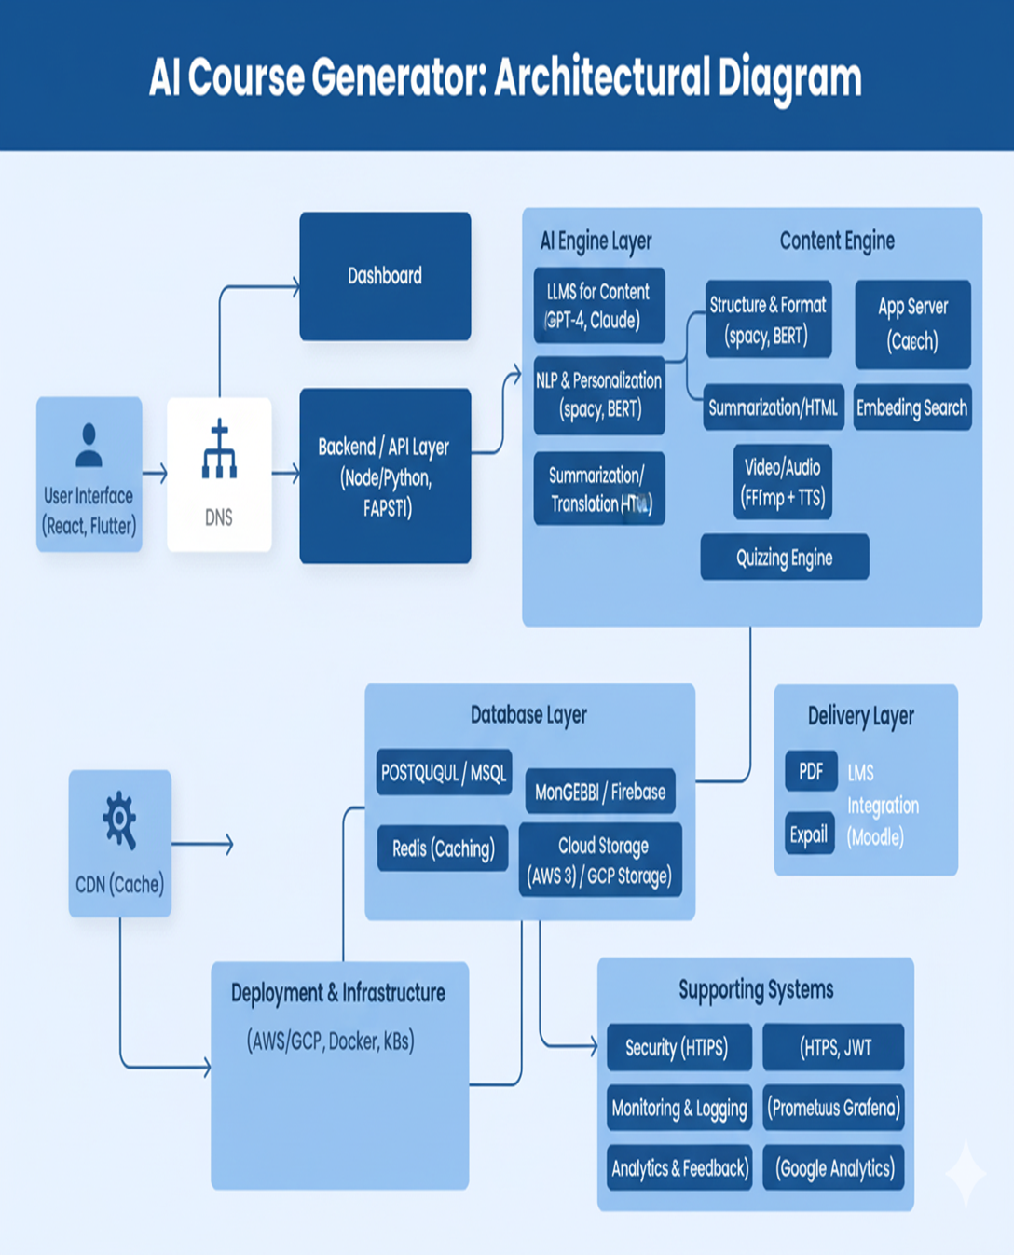

Slide 7
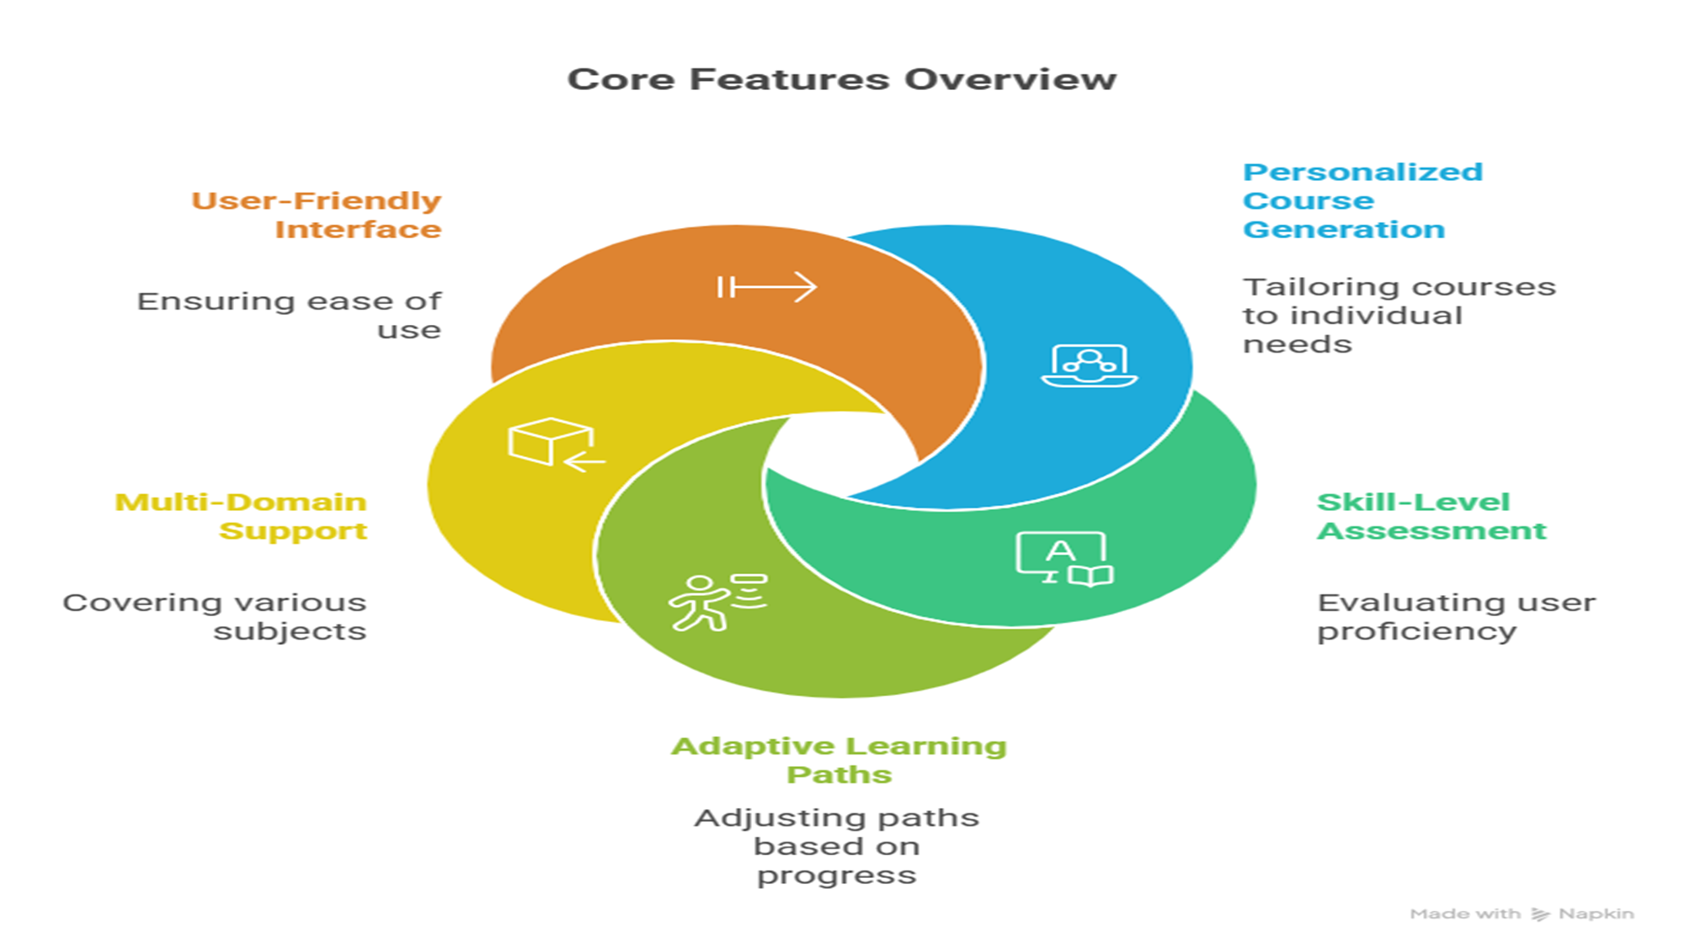


Slide 8
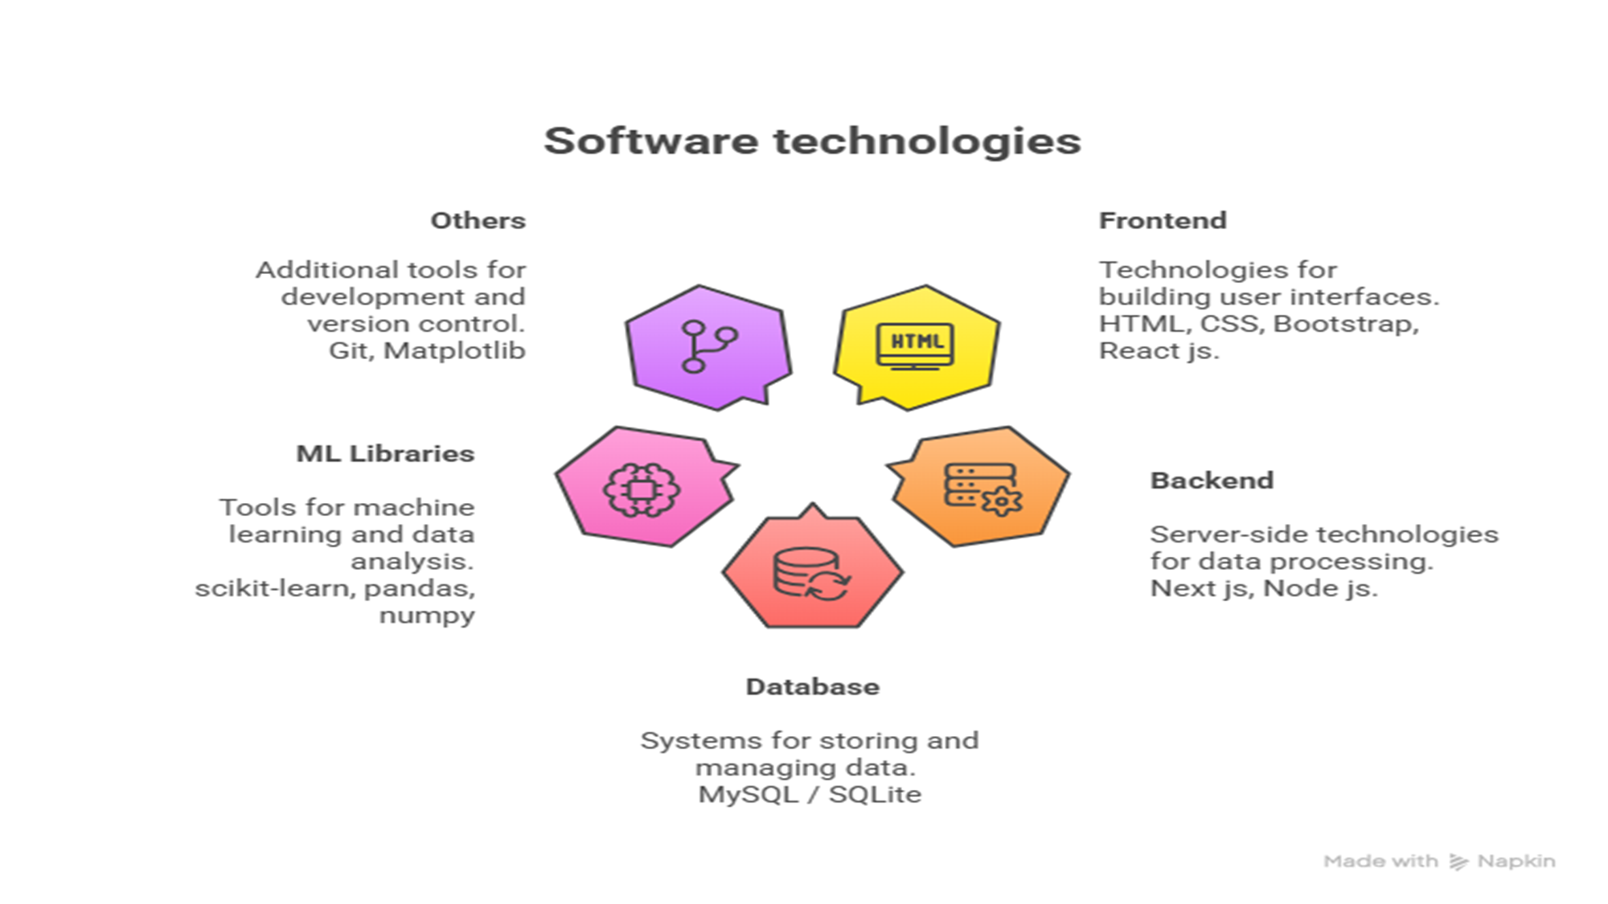

Slide 9
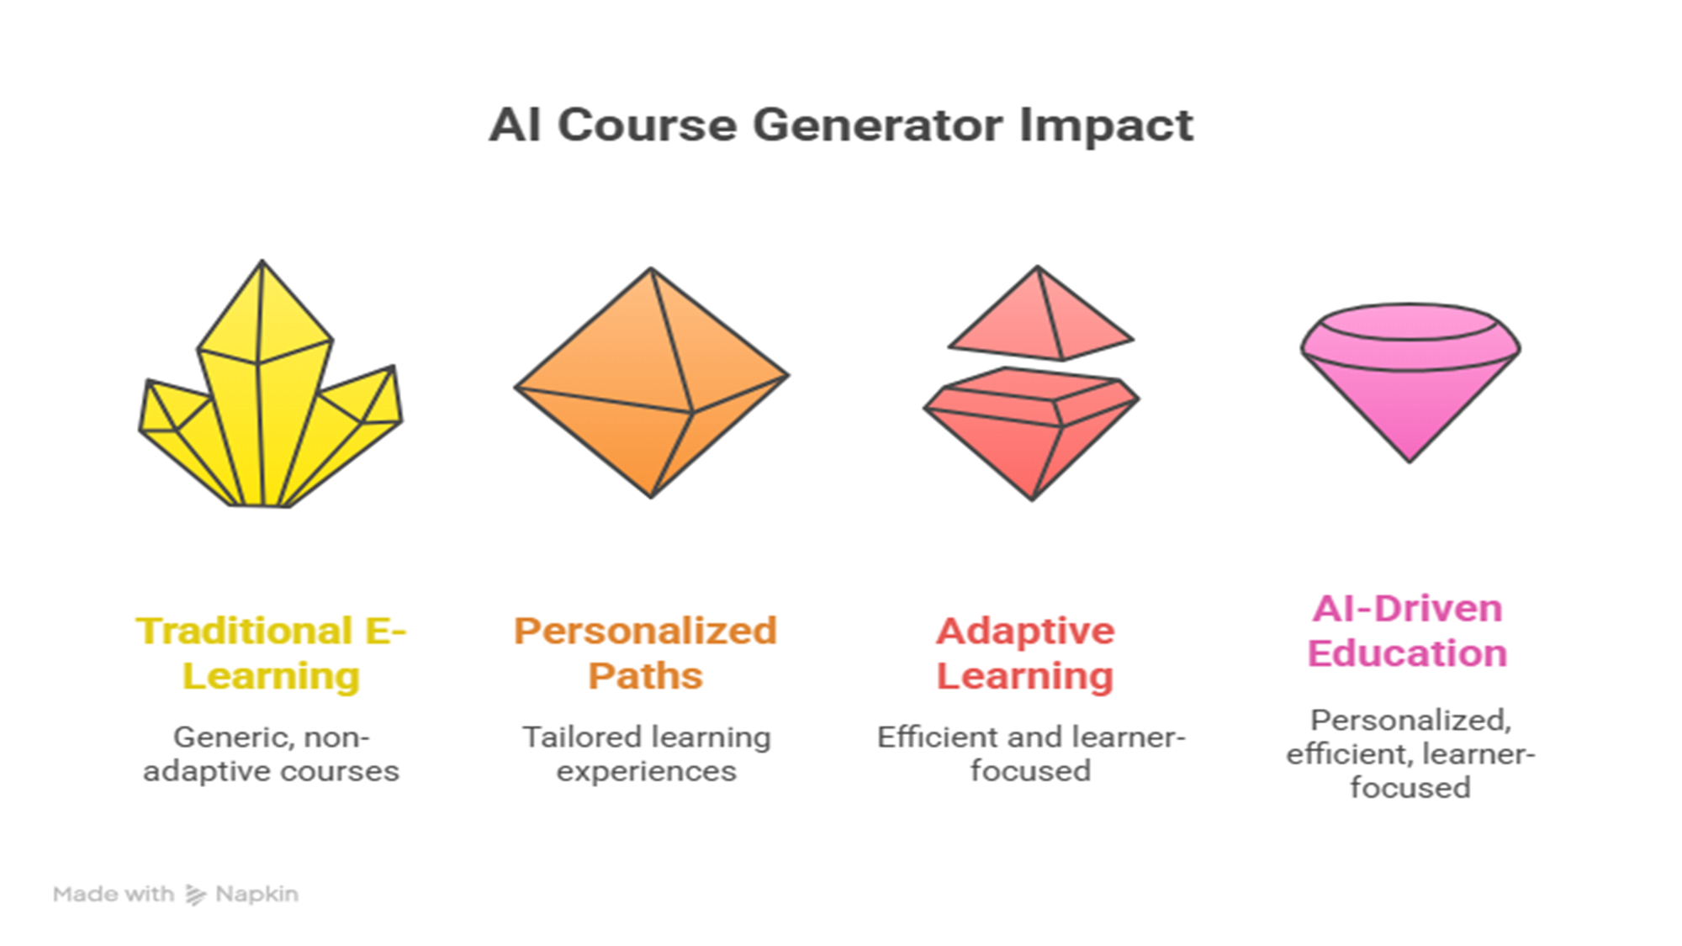

Slide 10
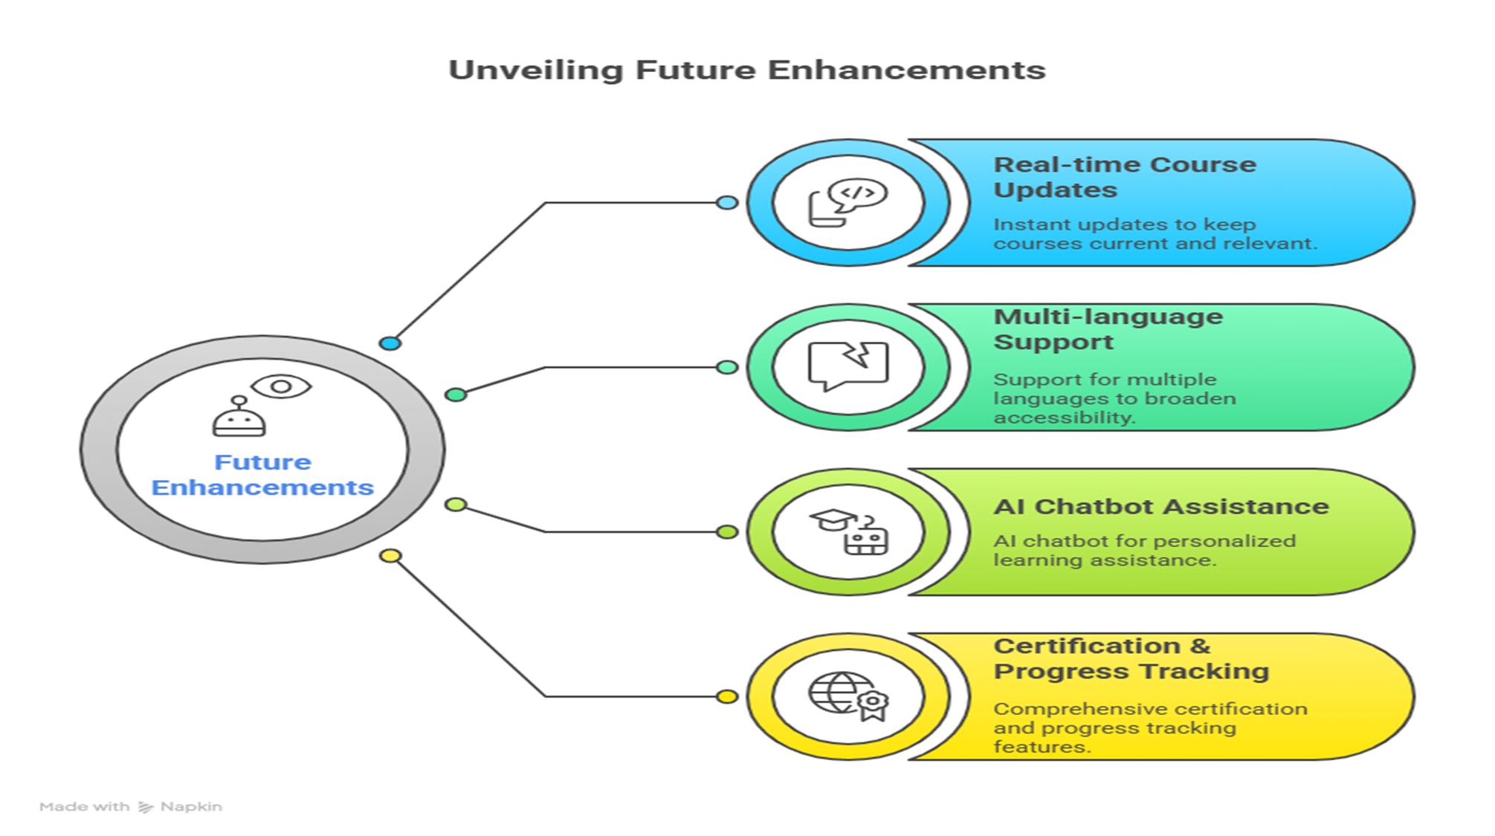


Slide 11
THANK YOU

